Slide 1




Hybrid Energy Prediction Using AI & Machine Learning
Subtitle: Solar + Wind Renewable Energy Forecasting
By
Name : J Koushik
Theme : Energy Prediction

Slide 2


Learning Objectives
Understand hybrid renewable energy forecasting.
Perform EDA & feature engineering on time-series energy data.
Build ML models (RF, XGBoost) and deep learning model (LSTM).
Compare model performance using evaluation metrics.
Deploy a prediction dashboard using Streamlit.
Generate meaningful visualizations for analysis.
GOAL: To predict future hybrid renewable energy generation (solar + wind) using AI/ML models to help in efficient power planning and grid management.

Slide 3
Tools and Technology used
Python
Pandas, NumPy
Matplotlib, Seaborn
Scikit-Learn (RandomForest, XGBoost)
TensorFlow/Keras (LSTM)
Streamlit Dashboard
Google Colab / VS Code

Slide 4
Methodology
1. Data Collection
Collected solar and wind energy production dataset from Kaggle.
2. Data Preprocessing
Cleaned missing values, corrected formats, and standardized datetime.
Created additional time-based features (Hour, Month, Day, DayOfWeek).
3. Feature Engineering
Added lag values, rolling averages, sine/cosine seasonal patterns.
Prepared data for traditional ML and LSTM models.
4. Model Development (AI + ML)
Trained three models: Random Forest, XGBoost, LSTM Neural Network.
AI learns hidden patterns in energy output based on time and source behavior.
5. Model Evaluation
Compared predictions with actual values using MAE, RMSE & R².
Selected the best-performing models.
6. Deployment using Streamlit
Built an interactive web app for real-time hybrid energy prediction.

Slide 5
Use of AI:
1️⃣ Data Understanding & Pattern Detection (AI Insight)
AI helps the system understand complex relationships between temperature, sunlight, wind speed, and energy output that humans cannot easily detect.
2️⃣ Intelligent Feature Learning (AI-driven Feature Engineering)
AI techniques identify which features affect energy output the most, such as:
Hour of the day
Wind + Solar interaction
Rolling averages
Seasonal trends
This improves prediction accuracy.
3️⃣ Smart ML Model Selection (AI Algorithms)
The project uses AI-powered models that learn, adapt, and generalize from the dataset:
Random Forest (AI ensemble decision model)
XGBoost (AI boosting algorithm)
LSTM Neural Network (AI deep learning model for time series)
These models simulate "AI intelligence" to make accurate predictions.

Slide 6
Use of AI:
4️⃣ Predictive Analytics (AI Decision Making)
AI models predict future hybrid energy output based on past behavior. This helps in planning grid load, energy storage, and resource management.
5️⃣ Real-time Prediction in Streamlit App (AI-Driven Output)
The Streamlit app uses trained AI models to:
Process new user inputs
Predict energy output instantly
Display intelligent, adaptive results
This is the practical AI usage visible to the evaluator.
“AI is used for understanding patterns, selecting important features, training advanced ML models, and making accurate energy predictions. It enables the project to think, learn, and forecast energy generation like a smart system.”

Slide 7
Problem Statement:
Due to the fluctuating nature of solar and wind energy, predicting future energy output is difficult.
Traditional methods fail to capture time-based variations such as:
hour-wise changes
weather dependency
seasonal fluctuations
sudden drops / peaks
Accurate prediction is essential for grid stability, demand planning, and sustainable power usage.

Slide 8
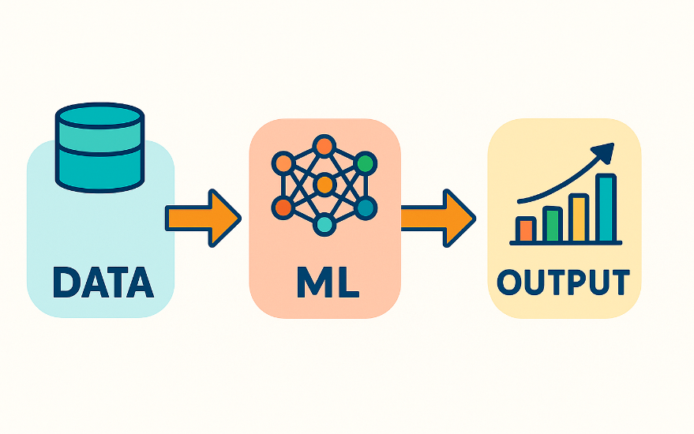
Solution:
We built an AI-powered system that:
Collects and preprocesses renewable energy data
Adds time-series features (lags, rolling windows, sine/cosine encodings)
Trains multiple models:
Random Forest
XGBoost
LSTM (Deep Learning)
Compares their performance
Deploys a Streamlit app to make predictions interactively

Slide 9
Feature Engineering:
Features created:
Time-Based Features:
Hour
Day
Month
DayOfWeek
Lag Features:
lag_1 (previous hour)
lag_3
Rolling Window Features:
rolling_3h
rolling_6h
Cyclic Features:
hour_sin, hour_cos
month_sin, month_cos
Hybrid Features:
solar_hour
wind_month

Slide 10
Machine Learning Models Used:
1. Random Forest
Handles non-linear data well
Good baseline model
2. XGBoost
Gradient boosting
High accuracy
3. LSTM (Deep Learning)
Captures sequential dependencies
Best for time-series prediction

Slide 11
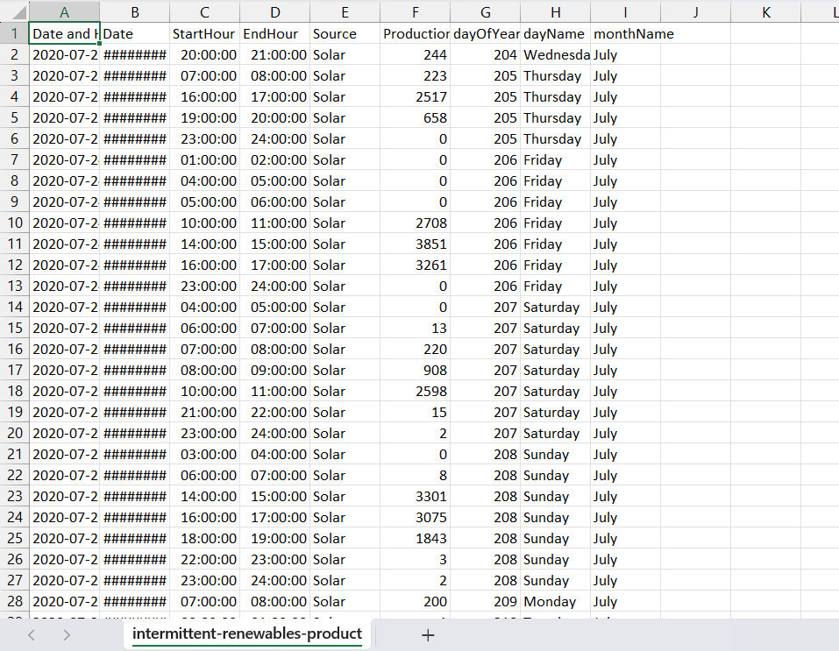
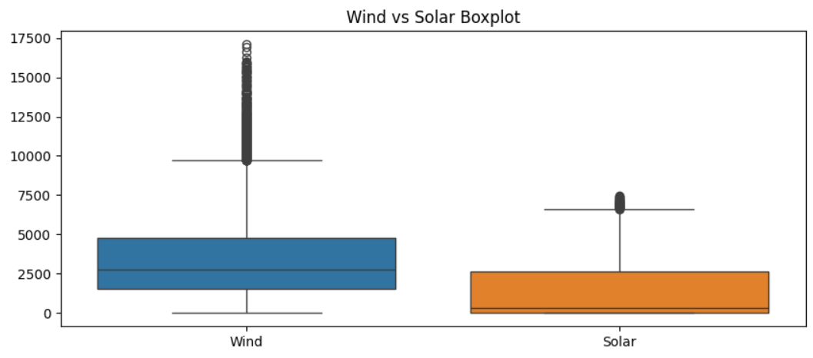
Screenshots of Outputs:-
Dataset Details:
Dataset: intermittent-renewables-production-france.csv
Source: Kaggle
Features:
Timestamp
Solar production
Wind production
Energy type
Data points: ~30,000
Nature: Time-series hourly data

Slide 12
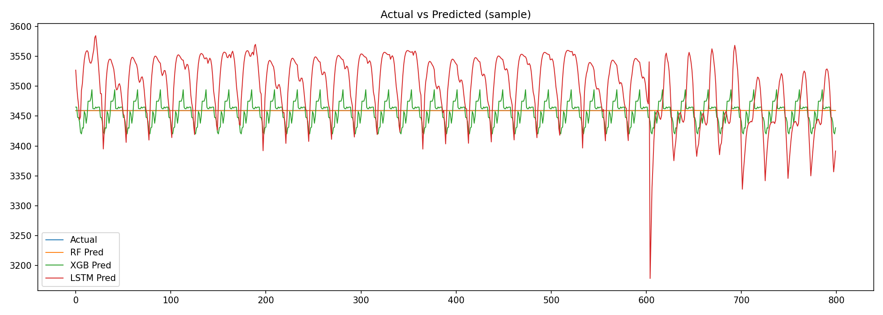
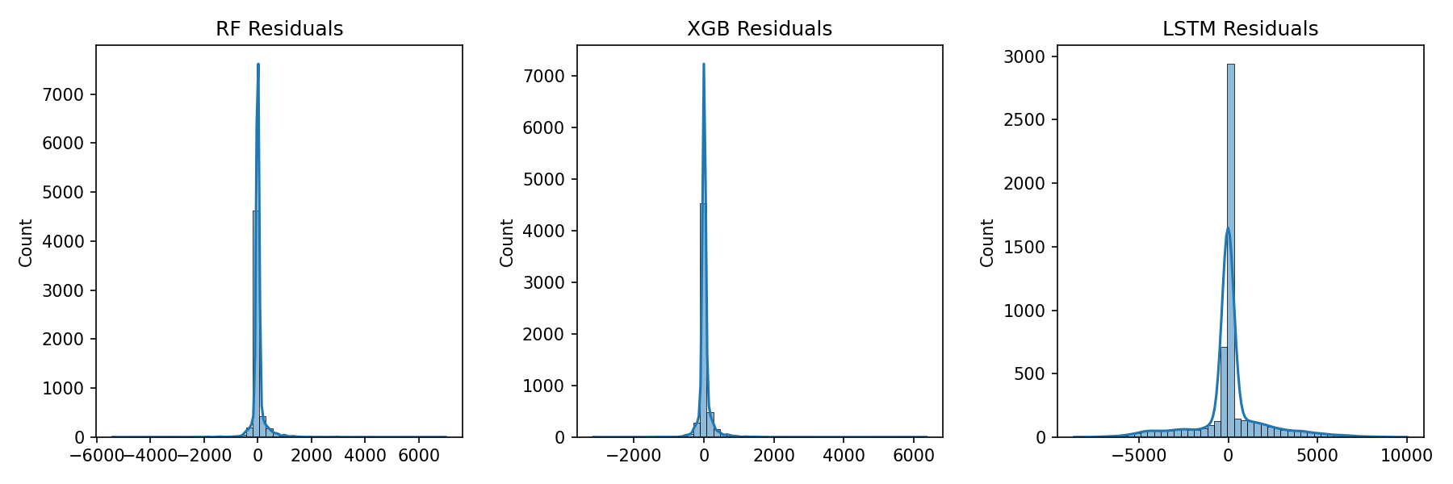
Exploratory Data Analysis:
Include plots:
Solar vs Wind over time
Distribution of energy production
Correlation heatmap
Hourly & Monthly trends

Slide 13
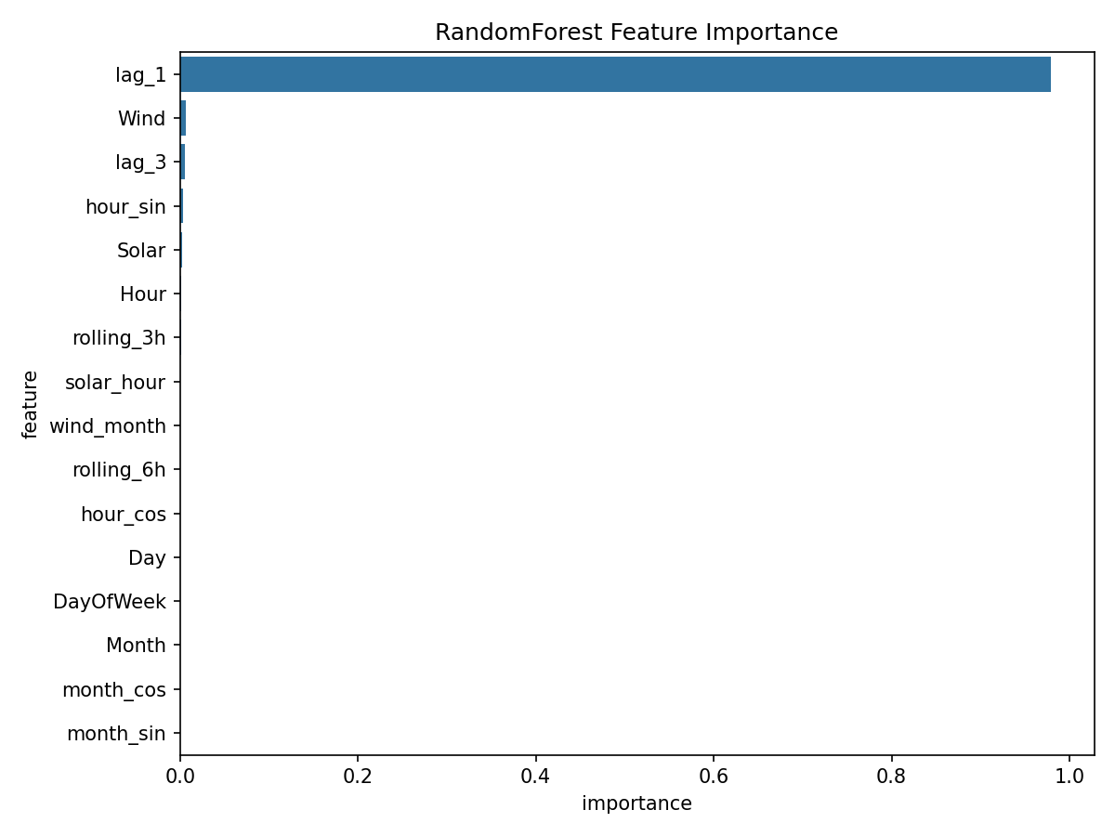
Model Training & Testing:
Train-Test Split: 80% – 20%
Models trained using scaled features
LSTM trained on 24-timesteps sequence window
Metrics Evaluated:
MAE
RMSE
R² Score

Slide 14
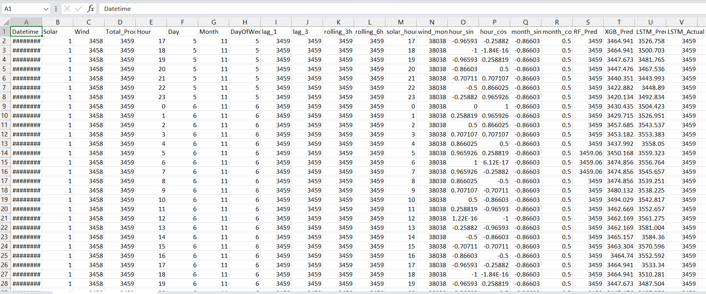
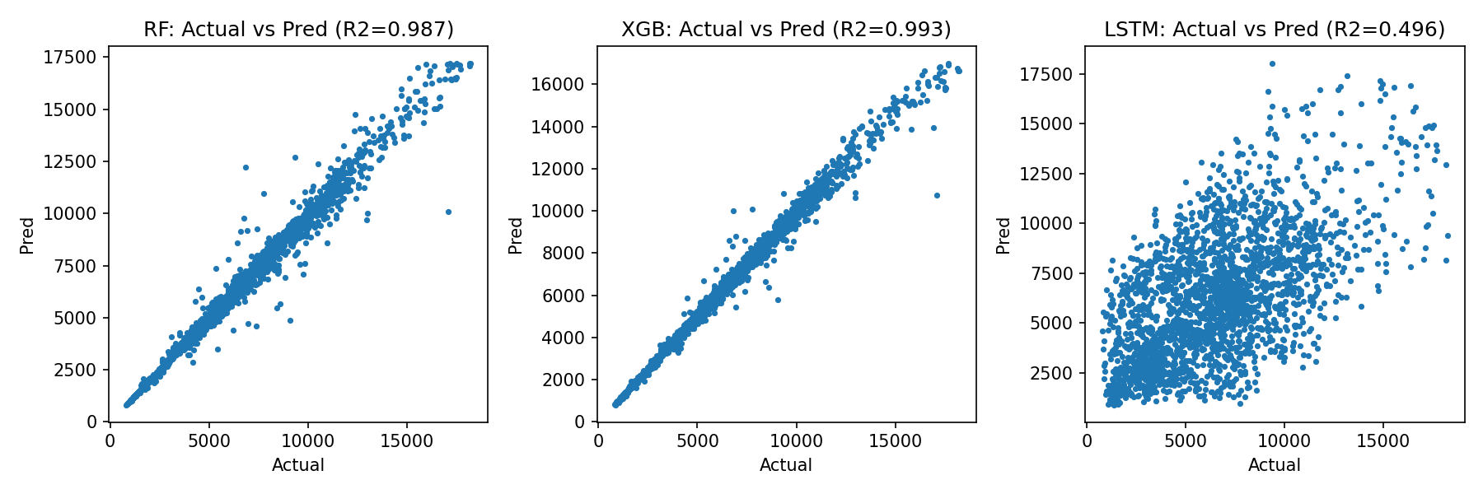
Prediction Results:
Model | Prediction (MW)
Random Forest | 710.71
XGBoost | 377.24
LSTM | 955.71
Merged_prediction_all_models

Slide 15
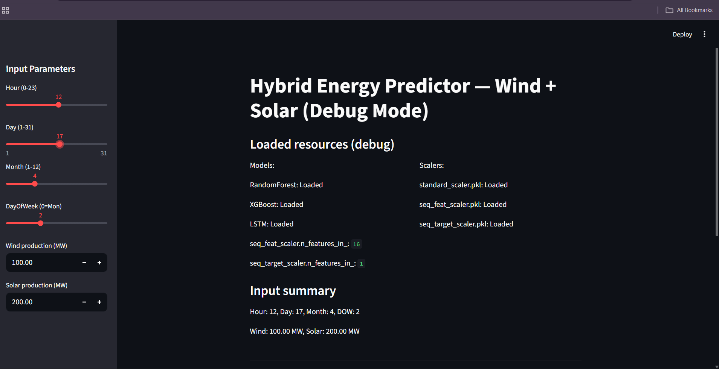
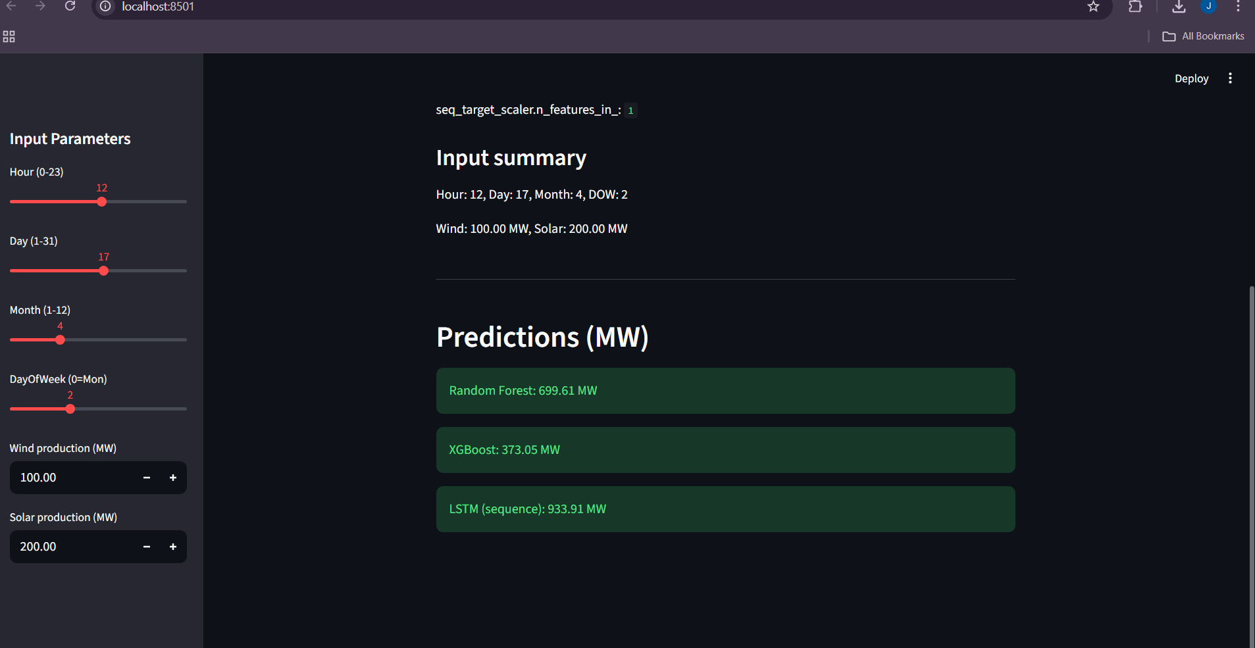
Streamlit App UI:
User inputs: Hour, Day, Month, Wind, Solar
App loads: RF, XGB, LSTM models
Output: Predicted energy (MW)
Debug mode shows scalers, loaded resources

Slide 16
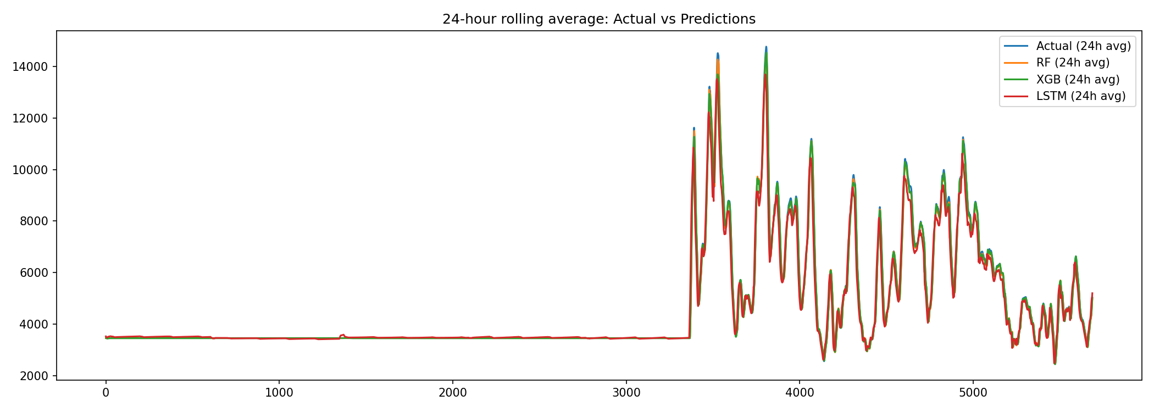
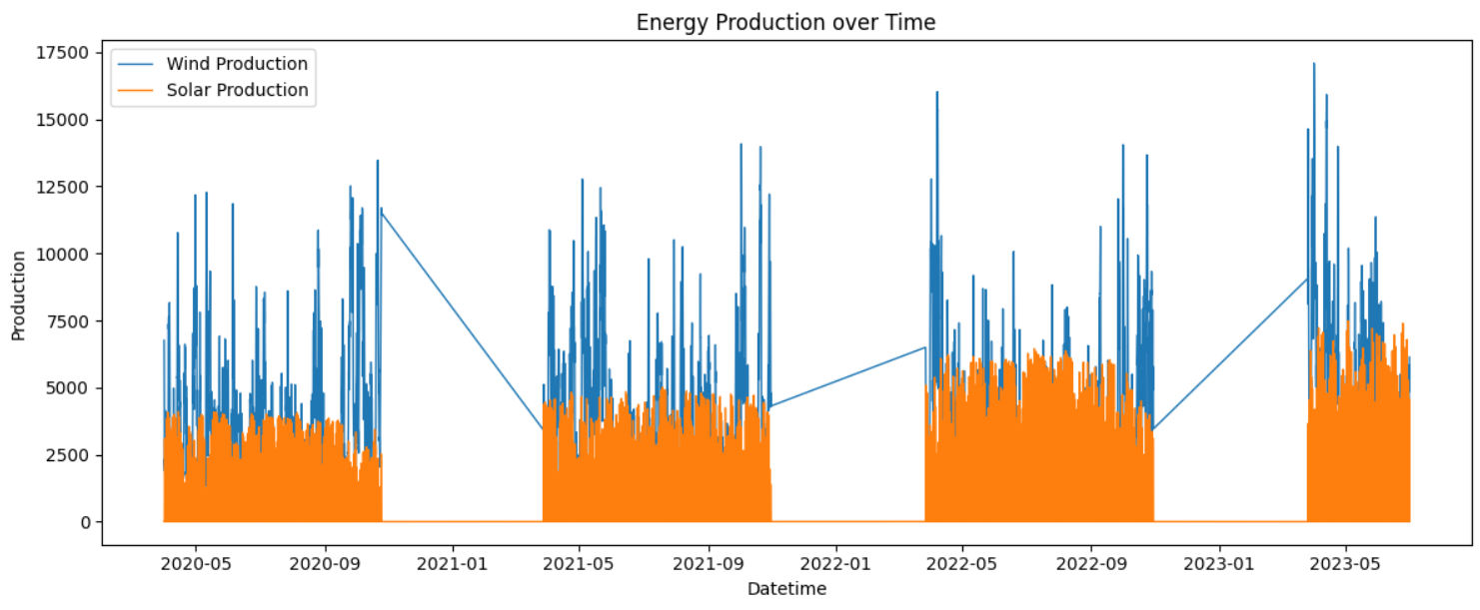

Slide 17
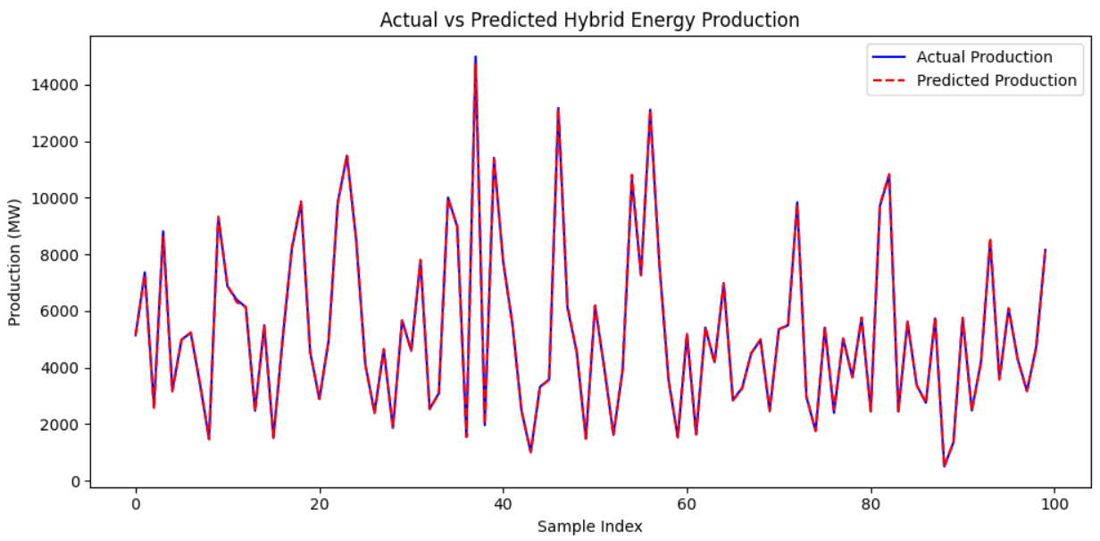
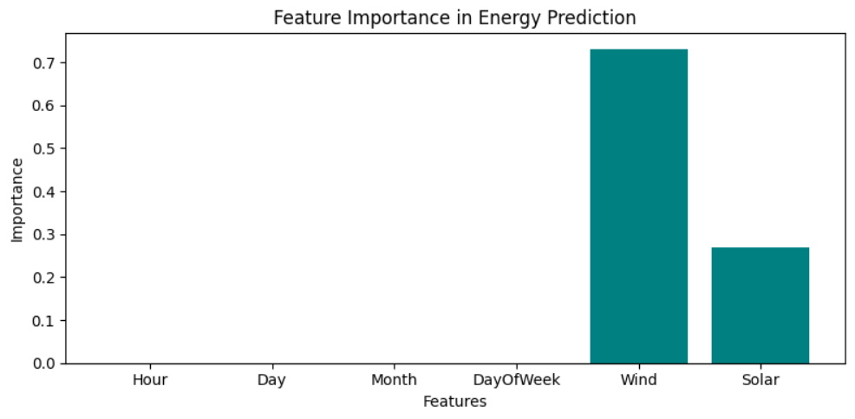

Slide 18
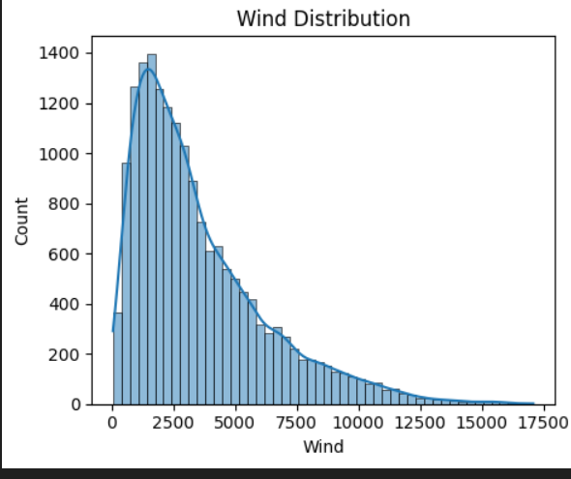
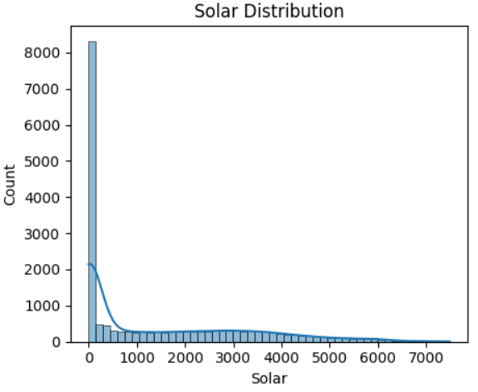
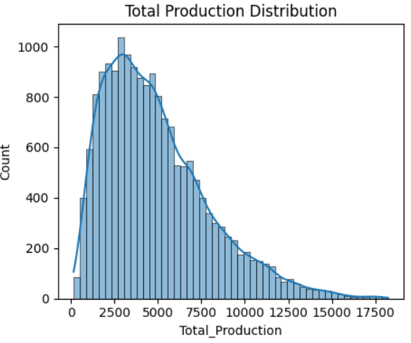

Slide 19
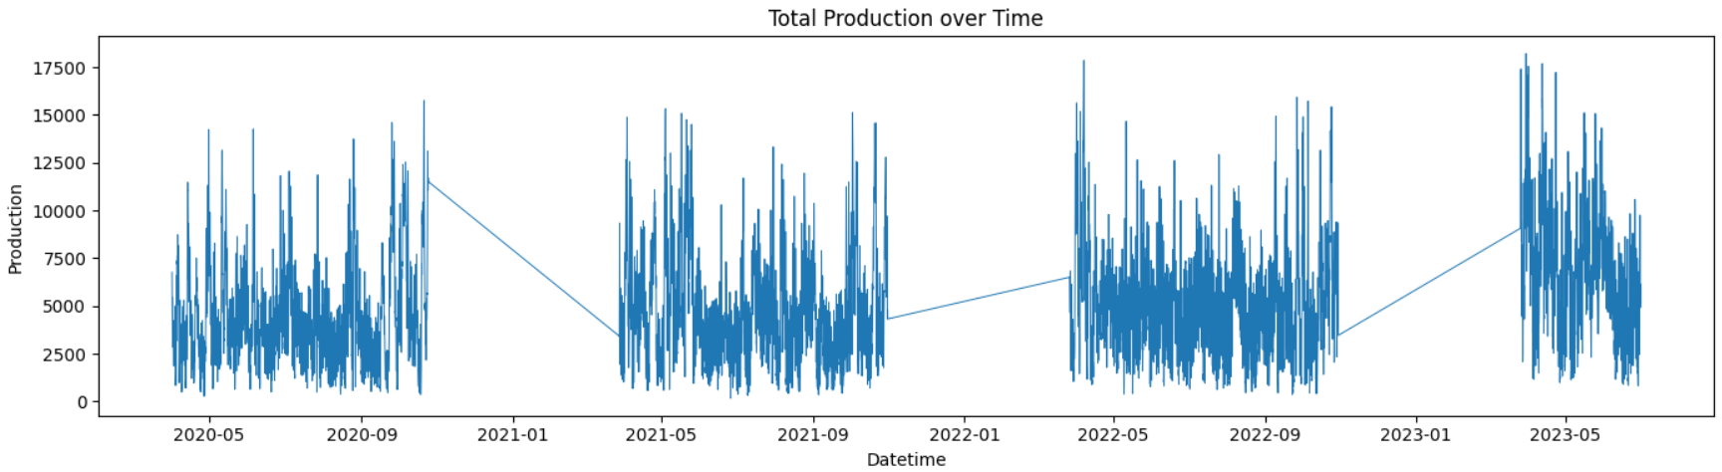
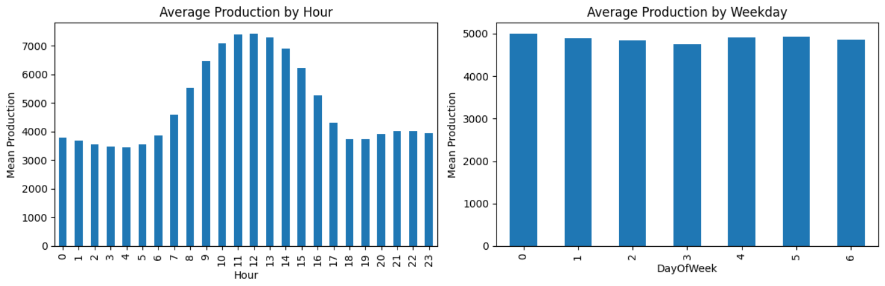

Slide 20
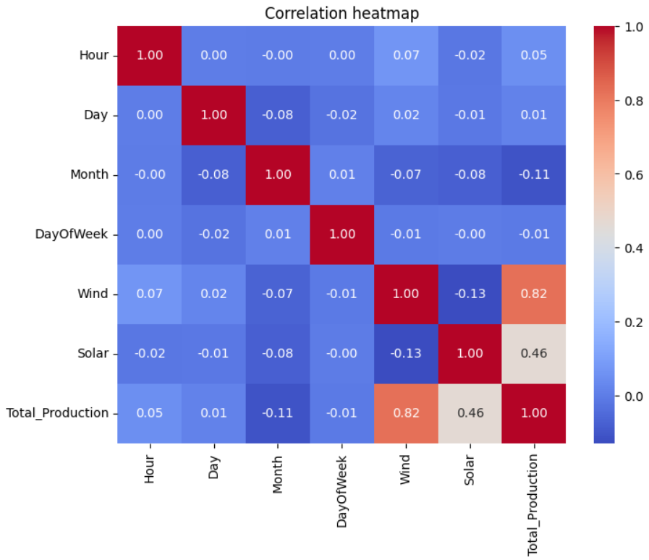

Slide 21
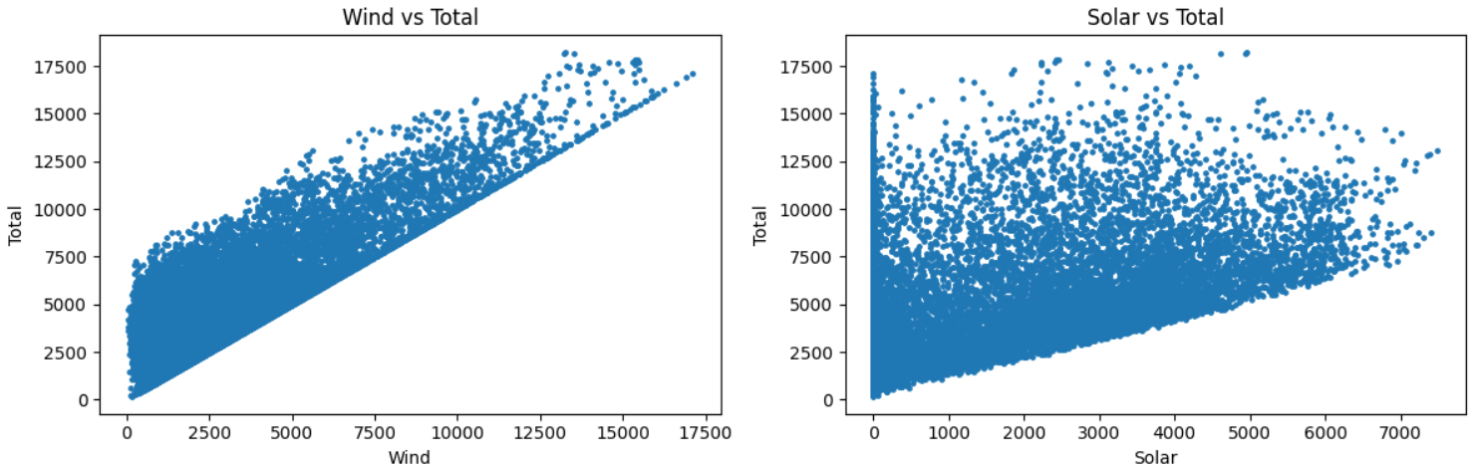
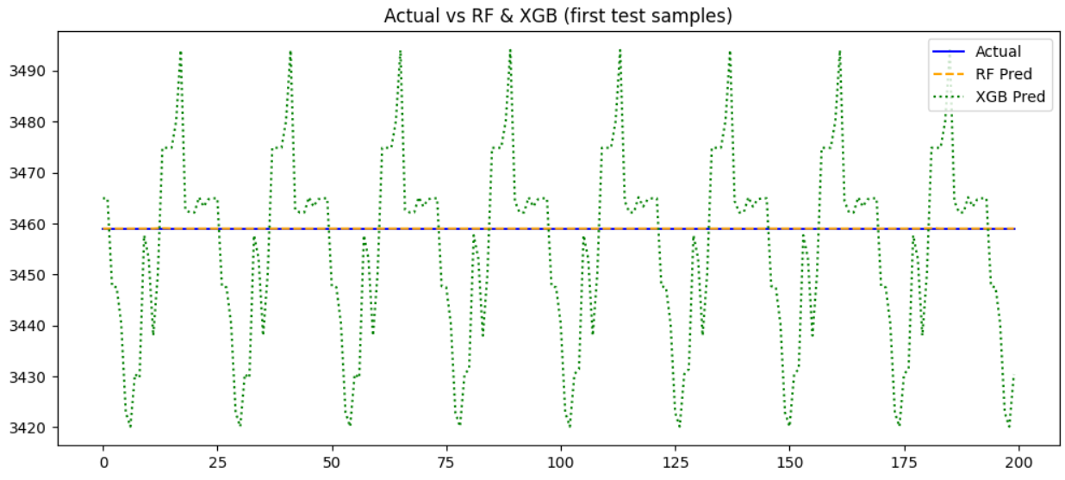
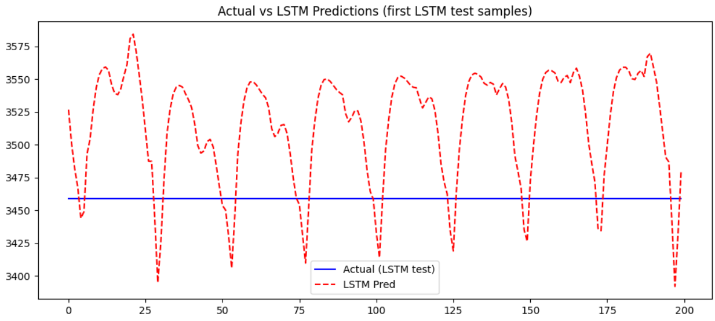

Slide 22
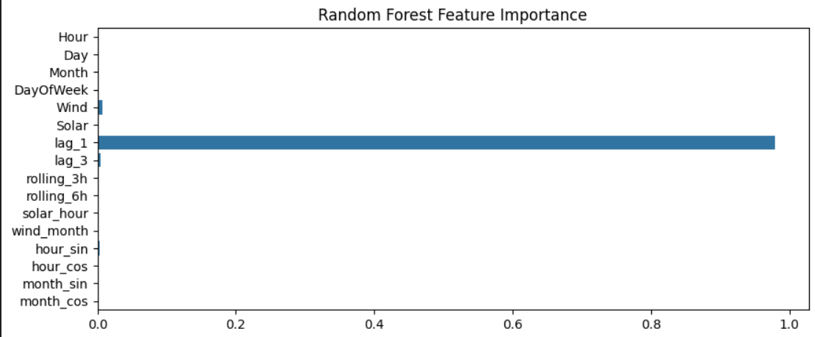
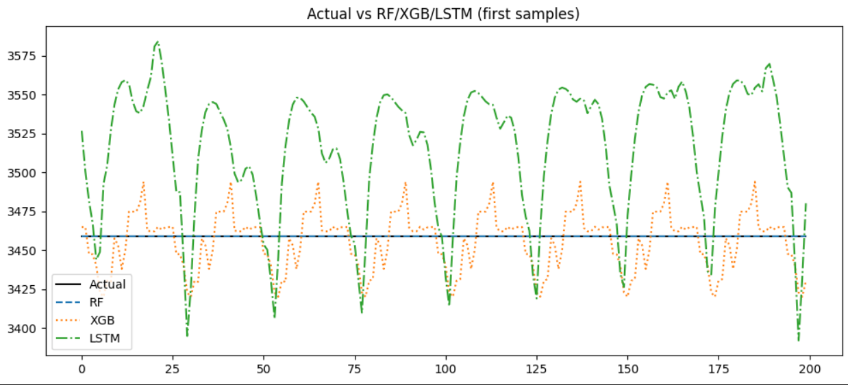

Slide 23

Conclusion:
Successfully implemented 100% hybrid energy prediction system
Completed:
Dataset cleaning
EDA
Feature Engineering
ML + DL Models
Evaluation
Streamlit Deployment
LSTM performed best for time-series prediction
Helpful for power management & renewable planning
AI is used to automatically analyze patterns in historical renewable energy data and generate
accurate future energy predictions using machine learning and deep learning models.

Slide 24

Contact Info
Koushik Juturu 📧 juturukoushik6@gmail.com 📱 +91-9398558037
GitHub Link
https://github.com/juturukoushik/hybrid_energy_prediction_project
Google Drive Link
https://drive.google.com/drive/folders/1RuKfbPeBBGhPLsjgFL7XiJLqKK1wOsS1?usp=sharing

